Slide 1

CSCE 222 Discrete Structures
Computational Models
Dr. Tim McGuire
Grateful acknowledgement to Dr. Michael P. Frank, University of Florida, for some of the material upon which these notes are adapted.

Slide 2
Based on Chapter 13 of Rosen Discrete Mathematics and its Applications

Slide 3
Modeling Computation
We learned earlier the concept of an algorithm.
A description of a computational procedure.
Now, how can we model the computer itself, and what it is doing when it carries out an algorithm?
For this, we want to model the abstract process of computation itself.

Slide 4
Early Models of Computation
Recursive Function Theory
Kleene, Church, Turing, Post, 1930’s
Turing Machines – Turing, 1940’s
RAM Machines – von Neumann, 1940’s
Cellular Automata – von Neumann, 1950’s
Finite-state machines, pushdown automata
various people, 1950’s
VLSI models – 1970s
Parallel RAMs, etc. – 1980’s

Slide 5
§13.1 – Languages & Grammars
Phrase-Structure Grammars
Types of Phrase-Structure Grammars
Derivation Trees
Backus-Naur Form

Slide 6
Computers as Transition Functions
A computer (or really any physical system) can be modeled as having, at any given time, a specific state s∈S from some (finite or infinite) state space S.
Also, at any time, the computer receives an input symbol i∈I and produces an output symbol o∈O.
Where I and O are sets of symbols.
Each “symbol” can encode an arbitrary amount of data.
A computer can then be modeled as simply being a transition function T:S×I → S×O.
Given the old state, and the input, this tells us what the computer’s new state and its output will be a moment later.
Every model of computing we’ll discuss can be viewed as just being some special case of this general picture.

Slide 7
Vocabularies and Sentences
Symbol – used without definition
e.g.: letters and digits
Alphabet – finite set of symbols
e.g.: English alphabet, binary alphabet {0,1}, ASCII, etc.
A fixed alphabet is usually denoted by Σ
String – finite sequence of symbols from a fixed alphabet Σ
Length of a string, s, is |s| = # of symbols in s
Length of abcabc is 6
λ is the empty string (Some texts use ε as the empty string)
|λ| = 0

Slide 8
Strings
String
Prefix of a string: if s = abcd, prefixes are λ, a, ab, abc, abcd
Suffix is analogously defined
Concatenation of two strings is the string formed by writing the first followed by the second with no intervening space
λ is the concatenation identity

Slide 9
Languages
Language – a set of strings over a fixed alphabet
can be { } (aka Ø), the empty language.
{} ≠ {λ} different languages!
e.g. set of all palindromes over {0,1},
Set of all strings over {0,1} = {λ, 0, 1, 00, 01, 10, 11, 000, 001, 010, 011, 100, 101, ... }

Slide 10
Operations on Languages
union – since languages are sets, the union of two languages L₁ and L₂ is already defined:
L₁ ∪ L₂ = { s | s ∈ L₁ or s ∈ L₂ }
Concatenation: L₁L₂ = { st | s ∈ L₁ and t ∈ L₂ }
“Exponentiation”
L⁰ ={λ} L^{i} = L^{i-1}L
Kleene Closure L* = ∪ L^{i}
Positive Closure L⁺ = ∪ L^{i} L* = L⁺ iff λ ∈ L
∞
i=0
∞
i=1

Slide 11
Suppose Σ = {a,b,c}. Some languages over Σ could be:
{aa,ab,ac,bb,bc,cc}
{ab,abc,abcc,abccc,. . .}
{λ}
{ }
{a,b,c, λ}
…

Slide 12
Grammars
A formal grammar G is any compact, precise mathematical definition of a language L.
As opposed to just a raw listing of all of the language’s legal sentences, or just examples of them.
A grammar implies an algorithm that would generate all legal sentences of the language.
Often, it takes the form of a set of recursive definitions.
A popular way to specify a grammar recursively is to specify it as a phrase-structure grammar.

Slide 13
Phrase-Structure Grammars
A phrase-structure grammar (abbr. PSG) G = (V,T,S,P) is a 4-tuple, in which:
V is a vocabulary (set of words)
The “template vocabulary” of the language.
T ⊆ V is a set of words called terminals
Actual words of the language.
Also, N :≡ V − T is a set of special “words” called nonterminals. (Representing concepts like “noun”)
S∈N is a special nonterminal, the start symbol.
P is a set of productions (to be defined).
Rules for substituting one sentence fragment for another.
A phrase-structure grammar is a special case of the more general concept of a string-rewriting system, due to Post.

Slide 14
Productions
A production p∈P is a pair p=(b,a) of sentence fragments l, r (not necessarily in L), which may generally contain a mix of both terminals and nonterminals.
We often denote the production as b → a.
Read “b goes to a” (like a directed graph edge)
Call b the “before” string, a the “after” string.
It is a kind of recursive definition meaning that If lbr ∈ L^{T}, then lar ∈ L^{T}. (L^{T} = sentence “templates”)
That is, if lbr is a legal sentence template, then so is lar.
That is, we can substitute a in place of b in any sentence template.
A phrase-structure grammar imposes the constraint that each l must contain a nonterminal symbol.

Slide 15
PSG Example – English Fragment
We have G = (V, T, S, P), where:
V = {(sentence), (noun phrase), (verb phrase), (article), (adjective), (noun), (verb), (adverb), a, the, large, hungry, rabbit, mathematician, eats, hops, quickly, wildly}
T = {a, the, large, hungry, rabbit, mathematician, eats, hops, quickly, wildly}
S = (sentence)
P = (see next slide)

Slide 16
Productions for our Language
P = { (sentence) → (noun phrase) (verb phrase), (noun phrase) → (article) (adjective) (noun), (noun phrase) → (article) (noun), (verb phrase) → (verb) (adverb), (verb phrase) → (verb), (article) → a, (article) → the, (adjective) → large, (adjective) → hungry, (noun) → rabbit, (noun) → mathematician, (verb) → eats, (verb) → hops, (adverb) → quickly, (adverb) → wildly }

Slide 17
Backus-Naur Form
⟨sentence⟩ ::= ⟨noun phrase⟩ ⟨verb phrase⟩
⟨noun phrase⟩ ::= ⟨article⟩ [⟨adjective⟩] ⟨noun⟩
⟨verb phrase⟩ ::= ⟨verb⟩ [⟨adverb⟩]
⟨article⟩ ::= a | the
⟨adjective⟩ ::= large | hungry
⟨noun⟩ ::= rabbit | mathematician
⟨verb⟩ ::= eats | hops
⟨adverb⟩ ::= quickly | wildly
Square brackets [] mean “optional”
Vertical bars mean “alternatives”

Slide 18
A Sample Sentence Derivation
(sentence) (noun phrase) (verb phrase)
(article) (adj.) (noun) (verb phrase)
(article) (adj.) (noun) (verb) (adverb)
the (adj.) (noun) (verb) (adverb) the large (noun) (verb) (adverb) the large rabbit (verb) (adverb)
the large rabbit hops (adverb)
the large rabbit hops quickly
On each step, we apply a production to a fragment of the previous sentence template to get a new sentence template. Finally, we end up with a sequence of terminals (real words), that is, a sentence of our language L.

Slide 19
Another Example
V
T
P
Let G = ({a, b, A, B, S}, {a, b}, S, {S → ABa, A → BB, B → ab, AB → b}).
One possible derivation in this grammar is: S ⇒ ABa ⇒ Aaba ⇒ BBaba ⇒ Bababa ⇒ abababa.
The symbol ⇒ is used to denote a single application of one production.
⇒* represents 0 or more applications of productions, so we could write the above as S ⇒* BBaba ⇒* abababa and say the S derives abababa

Slide 20
A Simple Definition of L(G)
The language L(G) (or just L) that is generated by a given phrase-structure grammar G=(V,T,S,P) can be defined by: L(G) = {w ∈ T* | S ⇒* w}
That is, L is simply the set of strings of terminals that are derivable from the start symbol.

Slide 21
Language Generated by a Grammar
Example: Let G = ({S,A,a,b},{a,b}, S, {S → aA, S → b, A → aa}). What is L(G)?
Easy: We can just draw a tree of all possible derivations.
We have: S ⇒ aA ⇒ aaa.
and S ⇒ b.
Answer: L = {aaa, b}.
S
aA
b
Example of a derivation tree or parse tree or sentence diagram.
aaa

Slide 22
Generating Infinite Languages
A simple PSG can easily generate an infinite language.
Example: S → 11S, S → 0 (T = {0,1}).
The derivations are:
S ⇒ 0
S ⇒ 11S ⇒ 110
S ⇒ 11S ⇒ 1111S ⇒ 11110
and so on…
L = {(11)*0} – the set of all strings consisting of some number of concaten- ations of 11 with itself, followed by 0.

Slide 23
Types of Grammars - Chomsky hierarchy of languages
Venn Diagram of Grammar Types:
Type 0 – Phrase-structure Grammars
Type 1 – Context-Sensitive
Type 2 – Context-Free
Type 3 – Regular

Slide 24
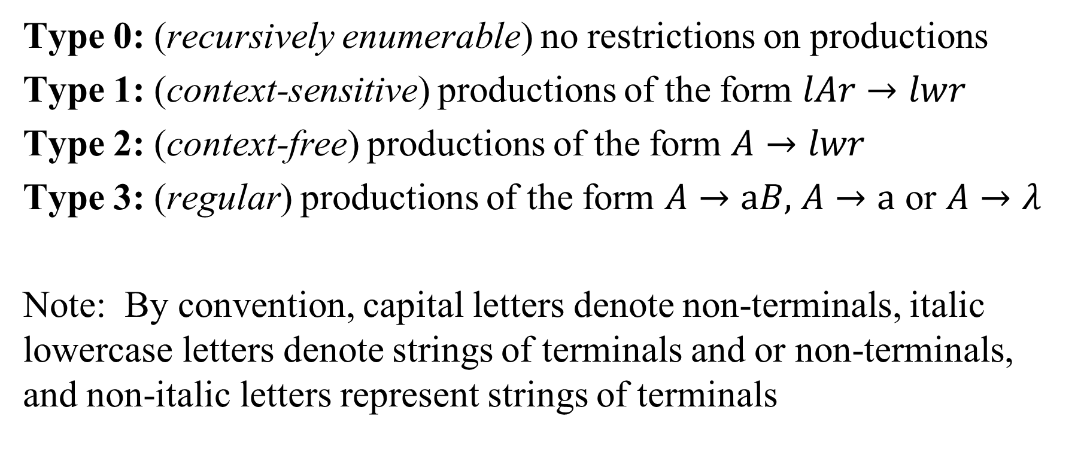
Defining the PSG Types
Type 0: (recursively enumerable) no restrictions on productions
Type 1: (context-sensitive) productions of the form $lAr→lwr$
Type 2: (context-free) productions of the form $A→lwr$
Type 3: (regular) productions of the form $A→aB,$ $A→a$ or $A→λ$
Note: By convention, capital letters denote non-terminals, italic lowercase letters denote strings of terminals and or non-terminals, and non-italic letters represent strings of terminals

Slide 25
A regular grammar is one where each production takes one of the following forms: (where the capital letters are non-terminals and w is a non-empty string of terminals):
S → λ,
S → w,
S → T,
S → wT.
Therefore, the grammar: S → 0S1, S → λ is not regular, it is context-free
Only one nonterminal can appear on the right side and it must be at the right end of the right side. Therefore the productions
A → aBc and S → TU
are not part of a regular grammar, but the production A → abcA is.

Slide 26
Regular Expressions for Regular Languages
An alternate way of expressing regular languages is via regular expressions
This is advantageous because the notation is more compact
Regular expressions are used widely in the text editors and scripting languages you will use in your career

Slide 27
Definition of Regular Expressions
Each regular expression r denotes a language L(r) (i.e., a set of strings)
Defn: The regular expressions over finite Σ are the strings over the alphabet {Σ + λ, ), (, |, * } such that:
Ø is a regular expression denoting the empty set
λ is a regular expression denoting the set {λ}
If a ∈ Σ then a is a regular expression denoting set { a }
(definition continued on next slide)

Slide 28
Definition of Regular Expressions (2)
4. If r is a regular expression denoting L(r) and s is a regular expression denoting L(s) then:
r | s is a regular expression denoting L(r) ∪ L(s) (union)
rs is a regular expression denoting L(r)L(s) (concatenation)
r* is a regular expression denoting (L(r))* (closure)

Slide 29
Precedence Rules for REs
* has highest precedence and is left associative
Concatenation has 2nd highest precedence and is left associative
| has lowest precedence and is left associative
Parentheses are used to change order of operations
Example: a | b*c ⬄ (a) | ((b)* (c))

Slide 30
Examples
If Σ = {a,b}
(a | b)(a | b) denotes {aa,ab,ba,bb}
(a | b)*b denotes all strings of a’s and b’s ending in b
a*b*a*
a*a (also known as a⁺)
(ab*)|(a*b)
(a|b)* = (a*b*)* (denote the same language – all strings of a’s and b’s)

Slide 31
Properties of regular expressions
r | s = s | r (commutativity of |)
r | (s | t) = (r | s) | t (associativity of |)
(rs)t = r(st)
r(s|t) = rs | rt
(s|t)r = sr | tr
rλ = λr = r
r** = r*

Slide 32
Notational Shorthands
r⁺ ≡ rr* (one or more)
r? ≡ r | λ (zero or one)
[abc] ≡ a | b | c where a, b, c ∈ Σ
[a-z] ≡ a | b | c | … | z
Examples
id → [A-Za-z][A-Za-z0-9]*
unsignednumber → [0-9]⁺(.[0-9] ⁺?(E(+|-)?[0-9]⁺)?
A little extreme

Slide 33


Slide 34
Definition: Context-Free Grammars
Grammar
Variables
Terminal
symbols
Start
variable
Productions of the form:
Variable
String of variables
and terminals

Slide 35
Example
The language { a^{n}b^{n}c^{n} | n ≥ 1} is context-sensitive but not context free.
A grammar for this language is given by:
S → aSBC | aBC
CB → BC
aB → ab
bB → bb
bC → bc
cC → cc

Slide 36
A derivation from this grammar is:-
S ⇒ aSBC
⇒ aaBCBC (using S → aBC)
⇒ aabCBC (using aB → ab)
⇒ aabBCC (using CB → BC)
⇒ aabbCC (using bB → bb)
⇒ aabbcC (using bC → bc)
⇒ aabbcc (using cC → cc)
which derives a²b²c².

Slide 37
§13.2 – Finite State Machines with Output

Slide 38
Remember the general picture of a computer as being a transition function T:S×I→S×O?
If the state set S is finite (not infinite), we call this system a finite state machine.
If the domain S×I is reasonably small, then we can specify T explicitly by writing out its complete graph.
However, this is practical only for machines that have a very small information capacity.

Slide 39
Vending Machine Example
Suppose a certain vending machine accepts nickels, dimes, and quarters.
If >30¢ is deposited, change is immediately returned.
If the “coke” button is pressed, the machine drops a coke.
Can then accept a new payment.
Ignore any other buttons, bills, out of change, etc.

Slide 40
Modeling the Machine
Input symbol set: I = {nickel, dime, quarter, button}
We could add “nothing” or ∅ as an additional input symbol if we want.
Representing “no input at a given time.”
Output symbol set: O = {∅, 5¢, 10¢, 15¢, 20¢, 25¢, coke}.
State set: S = {0, 5, 10, 15, 20, 25, 30}.
Representing how much money has been taken.

Slide 41
Transition Function Table
Old state | Input | New state | Output
0 | n | 5 | ∅
0 | d | 10 | ∅
0 | q | 25 | ∅
0 | b | 0 | ∅
5 | n | 10 | ∅
5 | d | 15 | ∅
5 | q | 30 | ∅
5 | b | 5 | ∅
Old state | Input | New state | Output
10 | n | 15 | ∅
10 | d | 20 | ∅
10 | q | 30 | 5¢
10 | b | 10 | ∅
15 | n | 20 | ∅
15 | d | 25 | ∅
15 | q | 30 | 10¢
15 | b | 5 | ∅

Slide 42
Transition Function Table cont.
Old state | Input | New state | Output
20 | n | 25 | ∅
20 | d | 30 | ∅
20 | q | 30 | 15¢
20 | b | 20 | ∅
25 | n | 30 | ∅
25 | d | 30 | 5¢
25 | q | 30 | 20¢
25 | b | 25 | ∅
Old state | Input | New state | Output
30 | n | 30 | 5¢
30 | d | 30 | 10¢
30 | q | 30 | 25¢
30 | b | 0 | coke

Slide 43
Another Format: State Table
Old state | Input Symbol
 | n | d | q | b
0 | 5,∅ | 10,∅ | 25,∅ | 0,∅
5 | 10,∅ | 15,∅ | 30,∅ | 5,∅
10 | 15,∅ | 20,∅ | 30,5¢ | 10,∅
15 | 20,∅ | 25,∅ | 30,10¢ | 15,∅
20 | 25,∅ | 30,∅ | 30,15¢ | 20,∅
25 | 30,∅ | 30,5¢ | 30,20¢ | 25,∅
30 | 30,5¢ | 30,10¢ | 30,25¢ | 0,coke
Each entry shows new state, output symbol

Slide 44
Directed-Graph State Diagram
As you can see, these can get kind of busy.
q,5¢
d,5¢
q
q
q,20¢
d
d
n
d
n
n
n
n
n
0
5
10
15
20
25
30
n,5¢
b
b
b
b
b
b
d,10¢
q,15¢
q,25¢
b,coke
q,10¢

Slide 45
Formalizing FSMs
Just like the general transition-function definition from earlier, but with the output function separated from the transition function, and with the various sets added in, along with an initial state.
A finite-state machine M=(S, I, O, f, g, s₀)
S is the state set.
I is the alphabet (vocabulary) of input symbols
O is the alphabet (vocabulary) of output symbols
f is the state transition function
g is the output function
s₀ is the initial state.
Our transition function from before is T = (f,g).

Slide 46
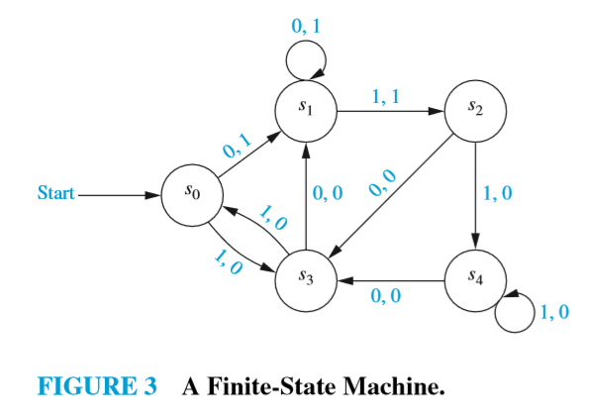
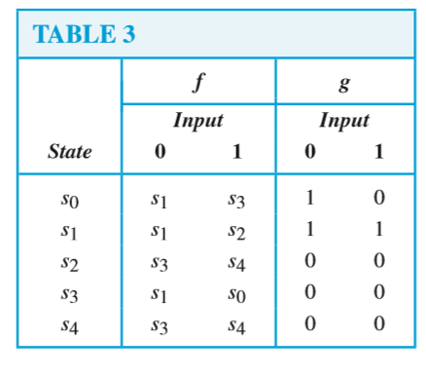
Construct a state table for the finite-state machine in Fig. 3.
Construct the state table for the FSM shown in Figure 3
Find the output string for the input 101011
A unit-delay machine: Construct a finite-state machine that delays an input string by one unit of time, e.g.,
Input: 0x₁x₂ … x_{k-1} Output: x₁x₂ … x_{k}

Slide 47
§13.23 – Finite State Machines with NO Output

Slide 48
Implementing Regular Expressions
Regular expressions, regular grammars reasonable way to generates strings in language
Not so good for recognizing when a string is in language
Regular expressions: which option to choose, how many repetitions to make
Answer: finite state automata

Slide 49
Three Equivalent Representations
Regular
expressions
Each
can
describe
the others
Regular
languages
Finite
automata
Kleene’s Theorem:
For every regular expression, there is a deterministic finite-state automaton that defines the same language, and vice versa.

Slide 50
Finite (State) Automata
A FA is similar to a compiler in that:
A compiler recognizes legal programs in some (source) language.
A finite-state machine recognizes legal strings in some language.
Example: Java Identifiers
sequences of one or more letters or digits, starting with a letter:
letter | digit
letter
S
A

Slide 51
Finite Automaton
Input
String
Output
“Accept”
or
“Reject”
Finite
Automaton

Slide 52
Finite State Automata
A finite state automation over an alphabet is illustrated by a state diagram:
a directed graph
edges are labeled with elements of alphabet,
some nodes (or states), marked as final
one node marked as start state

Slide 53
Nondeterministic Finite Automata
A nondeterministic finite automaton (NFA) is a mathematical model denoted by the 5-tuple (S, Σ, δ, s₀, F) where
S is a set of states
Σ is an input alphabet
δ is a transition function that maps state/symbol pairs to a set of states:
S x {Σ + λ} → set of S
s₀ ∈ S is a special state called the start state
F ⊆ S is a set of accepting states
INPUT: string
OUTPUT: yes or no

Slide 54
Transition Graph
An NFA can be diagrammatically represented by a labeled directed graph called a transition graph
a
S = {0,1,2,3} Σ = {a,b} s₀ = 0 F = {3}
start
a
b
b
0
1
2
3
b

Slide 55
Transition Table
The mapping δ of an NFA can be represented in a transition table
State | Input a | Input b
0 | {0, 1} | {0}
1 |  | {2}
2 |  | {3}
δ(0,a) = {0,1} δ(0,b) = {0} δ(1,b) = {2} δ(2,b) = {3}

Slide 56
The Language Defined by an NFA
An NFA accepts an input string x if and only if there is some path with edges labeled with symbols from x in sequence from the start state to some accepting state in the transition graph
A state transition from one state to another on the path is called a move
The language defined by an NFA is the set of input strings it accepts, such as (a⏐b)*abb for the example NFA

Slide 57
Example NFA
Transition Table:
λ
STATE | a | b | λ
0 | 0,1 | 0 | 3
1 |  | 2
2 |  | 3
3
0
a
1
b
2
b
3
a,b
S = {0,1,2,3}
S₀ = 0
Σ = {a,b}
F = {3}
The language accepted by an NFA: the set of strings it accepts
For example, the language accepted here is (a|b)*(abb | ε)

Slide 58
Deterministic Finite Automata
A deterministic finite automaton is a special case of an NFA
No state has an λ-move
For each state s and input symbol a there is at most one edge labeled a leaving s
Each entry in the transition table is a single state
At most one path exists to accept a string
Simulation algorithm is simple

Slide 59
DFA Examples

Slide 60
Transition Graph
initial
state
accepting
state
transition
state

Slide 61
Initial Configuration
Input String

Slide 62
Reading the Input

Slide 66
Input finished
accept

Slide 67
Rejection

Slide 71
Input finished
reject

Slide 72
Another Rejection

Slide 73
reject

Slide 74
Another Example

Slide 78
Input finished
accept

Slide 79
Rejection Example

Slide 83
Input finished
reject

Slide 84
Deterministic FSA’s
If FSA has for every state exactly one edge for each letter in alphabet then FSA is deterministic
In general FSA in non-deterministic.
Deterministic FSA special kind of non-deterministic FSA

Slide 85
Example FSA
Regular expression: (0 | 1)* 1
Deterministic FSA
0
1
1
0

Slide 86
Example NFSA
Regular expression: (0 | 1)* 1
Accepts string 0 1 1 0 1
0
1
1

Slide 87
Regular Languages
There is an algorithm for converting any RE into an NFA.
There is an algorithm for converting any NFA to a DFA.
There is an algorithm for converting any DFA to a RE.
These facts tell us that REs, NFAs and DFAs have equivalent expressive power. All three describe the class of regular languages.

Slide 88
From Regular Expression to NFA (Thompson’s Construction)
λ
start
λ
i
f
a
start
a
i
f
λ
λ
r₁⏐r₂
start
N(r₁)
i
f
λ
N(r₂)
λ
r₁r₂
start
i
N(r₁)
N(r₂)
f
λ
r*
start
λ
λ
i
N(r)
f
λ

Slide 89
Converting Regular Expressions to NFAs (Thompson’s Construction)
Note: We base this directly from the definition of r.e.’s
The regular expressions over finite Σ are the strings over the alphabet Σ + { ), (, |, *} such that:
Empty string λ is a regular expression denoting {λ}
a is a regular expression denoting {a } for any a in Σ
λ
a

Slide 90
Converting Regular Expressions to NFAs
If P and Q are regular expressions with NFAs N_{p}, N_{q}:
P | Q (union)
PQ (concatenation)
N_{p}
λ
λ
λ
λ
N_{q}
N_{p}
N_{q}
λ
λ
λ

Slide 91
Converting Regular Expressions to NFAs
If Q is a regular expression with NFA N_{q}:
Q* (closure)
λ
N_{q}
λ
λ
λ

Slide 92
Example (ab* | a*b)*
Starting with:
ab*
a
b
1
2
a*b
3
4
b
a
Note: We have already used as shortcut for b*, which by Thompson’s construction should be:
ab* | a*b
a
λ
1
2
λ
λ
5
b
6
λ
b
λ
λ
λ
3
b
4
λ
a

Slide 93
Example (ab* | a*b)*
Starting with:
ab*
a
b
1
2
a*b
3
4
b
a
ab* | a*b
a
λ
1
2
λ
5
b
6
ε
λ
3
b
4
a

Slide 94
Example (ab* | a*b)*
ab* | a*b
a
λ
1
2
λ
5
b
6
λ
3
b
4
λ
(ab* | a*b)*
a
a
λ
1
2
λ
λ
λ
7
5
b
6
8
λ
λ
λ
b
λ
3
4
a

